Slide 1
Cool Arduino projekti
Tomislav Teskač
Kristian Dekarin

Slide 2
Agenda
Arduino & IOT
How to start? What do I need? How much does it cost?
Arduino I klonovi
Senzori, aktulatori, motori
IDE -Visual studio Micro, Atmel studio, Arduino
Example projekta: Dron i autic

Slide 3

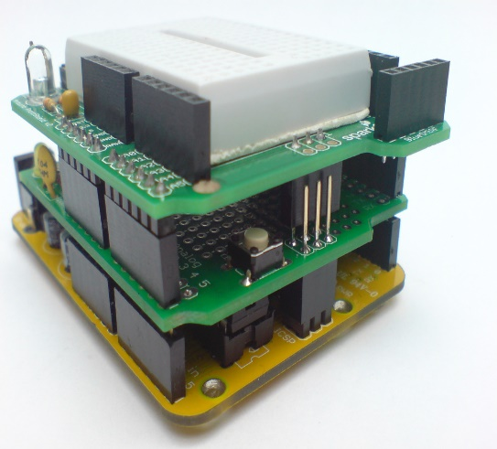
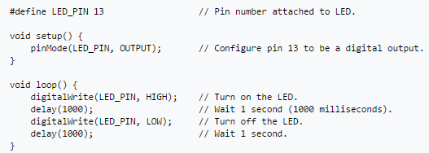
SparkFun & Adafruit - “low cost, simple tools for non-engineers to create digital projects”
Open sourced h/s microcontroler
Arduino extensions, shields?
How to write Sketch: AVR Studio, Atmel Studio, Arduino IDE, VS Micro
Arduino in numbers:
Downloaded x times
Sketch basic functions:
Arduino in numbers:
2011 - 300 000
2013 - 700 000

Slide 4
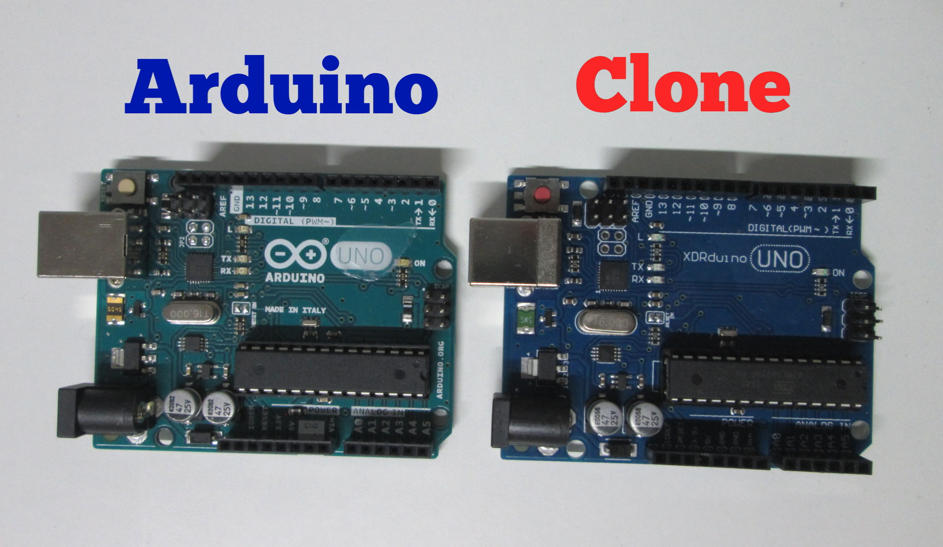
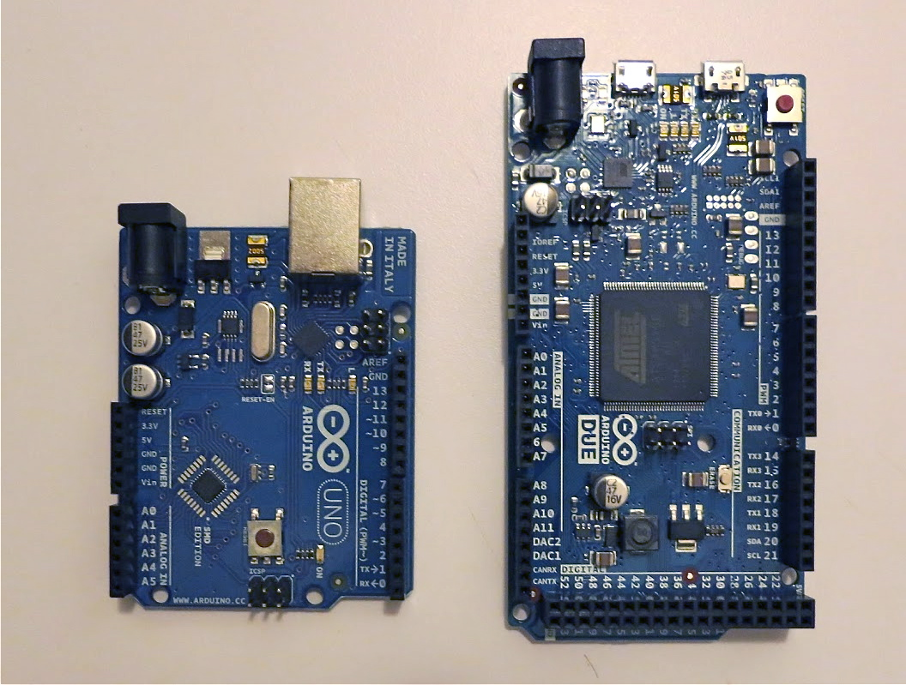
Clone or original
Arduino Nano, Uno, Due?

Slide 5
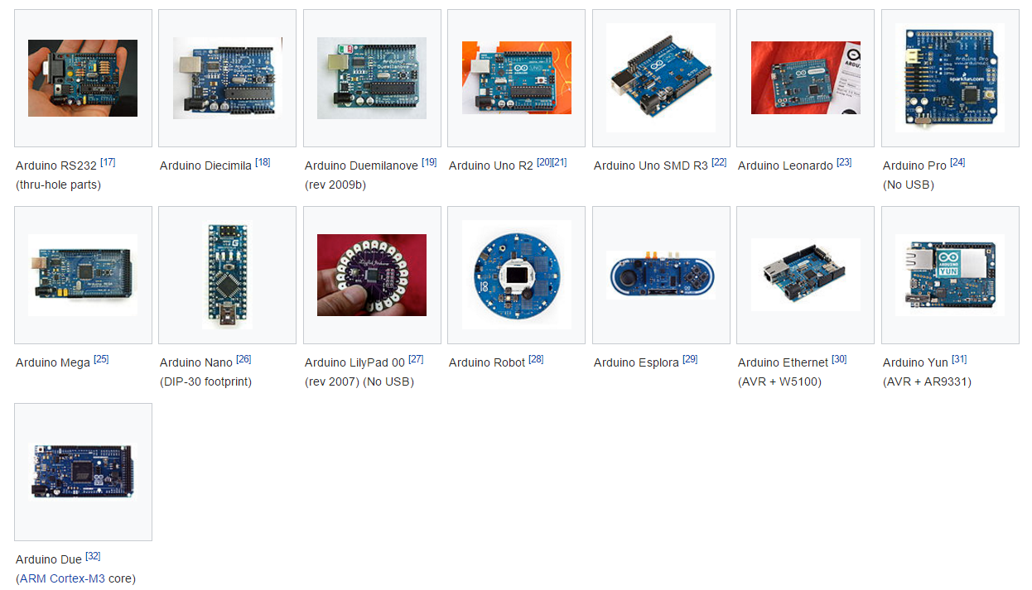

Slide 6
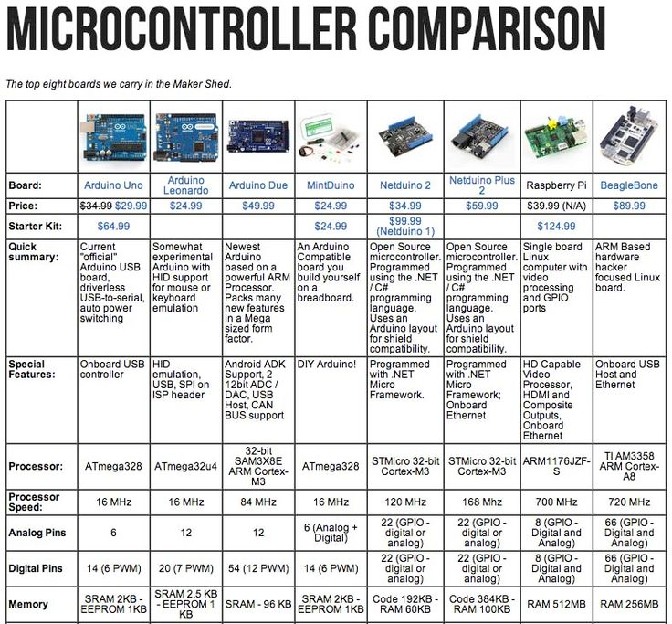

Slide 7
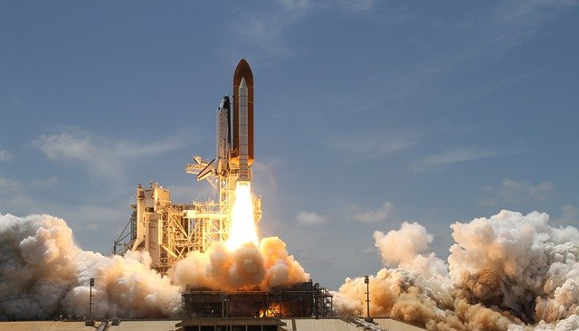
Used for? 2009 -> NASA
* A joke ☺

Slide 8
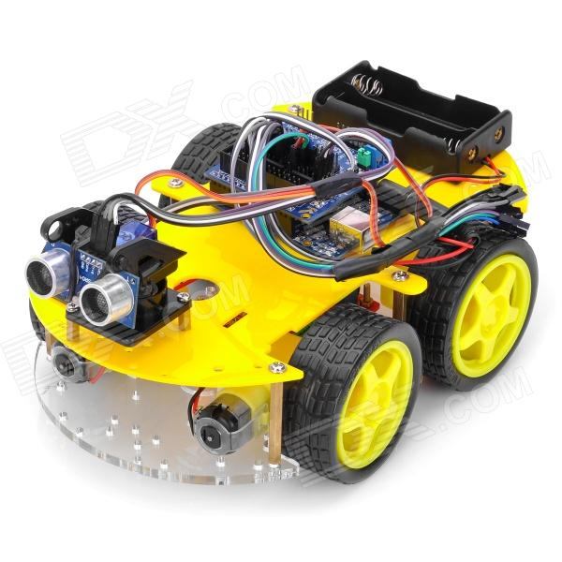
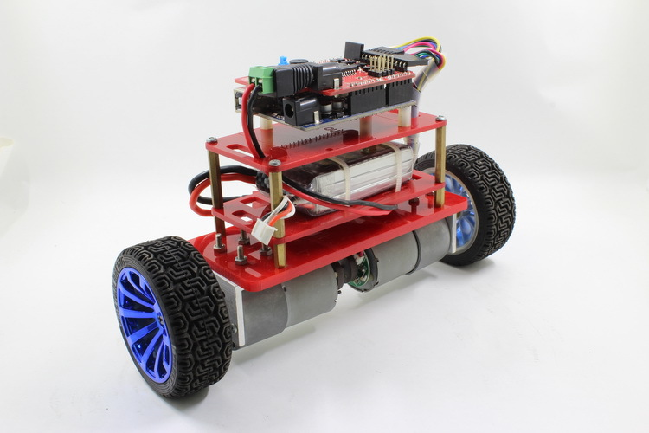
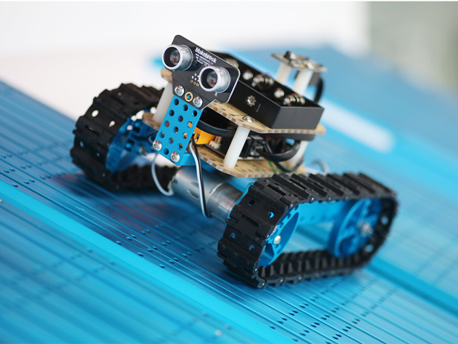
Used for?
Display LCD (weather, notes)
Any kind of toy (electronic piano,Wifi controller RC)
Alarm
Smart phone dore opener
Lamps
Home automatization Server
Email notifier
Maze Solver Robot
More @: http://playground.arduino.cc/Projects/Ideas

Slide 9
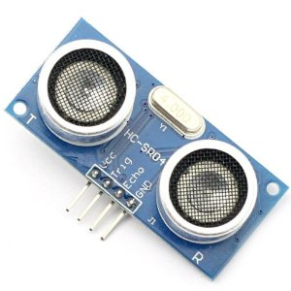
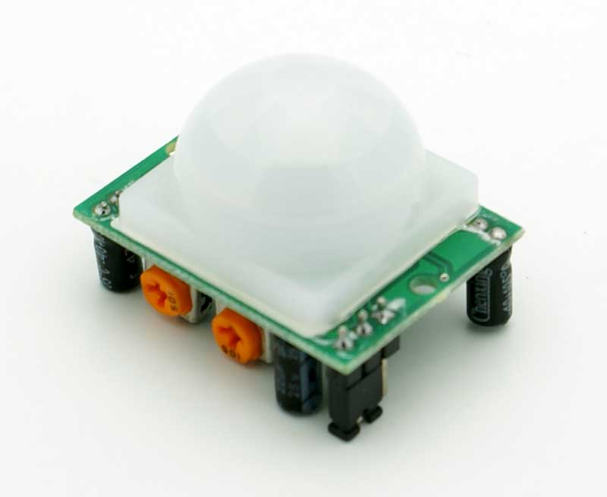
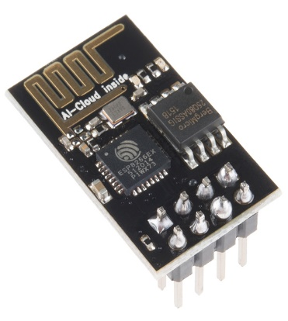
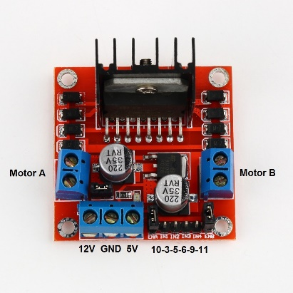
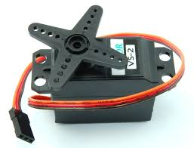
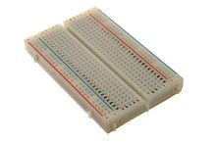
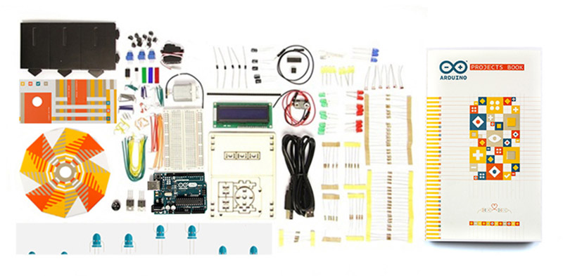
Used with:
JoyStick Module
Potentiometer
Transmiter -> Reciver, ESC8266, Bluetooth
Hbridge
Servo – Steper Motors,
KeyPad membrane
Buzzers
LCDs,
Temp sensor
LEDs Strip…
Boards,
Lipos > Checker,
Connectors,
Wires + (crocodile wires)
Lemilica… ?

Slide 10
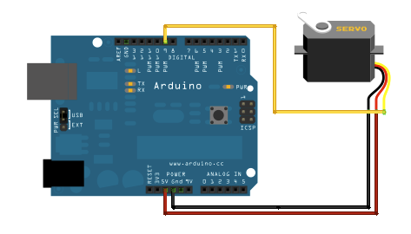
Example projekta Arduino servo
#include <SoftwareSerial.h>
#include <Servo.h>
Servo myservo; // create servo object to control a servo
// twelve servo objects can be created on most boards
int pos = 0; // variable to store the servo position
void setup() {
myservo.attach(9); // attaches the servo on pin 9 to the servo object
}
void loop() {
for (pos = 0; pos <= 180; pos += 1) { // goes from 0 degrees to 180 degrees
// in steps of 1 degree
myservo.write(pos); // tell servo to go to position in variable 'pos'
delay(15); // waits 15ms for the servo to reach the position
}
for (pos = 180; pos >= 0; pos -= 1) { // goes from 180 degrees to 0 degrees
myservo.write(pos); // tell servo to go to position in variable 'pos'
delay(15); // waits 15ms for the servo to reach the position
}
}

Slide 11
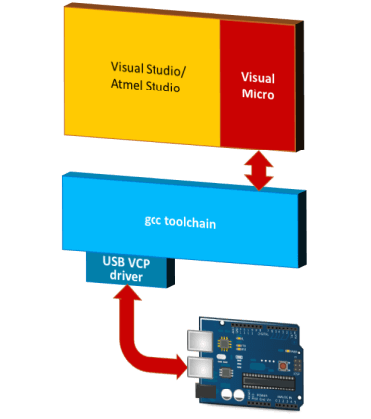
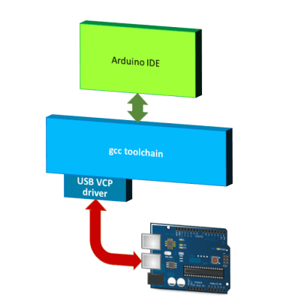
VS Micro & Arduino IDE
The gcc toolchain consists of all tools that run in the background if you select "build" or "upload" commands.

Slide 12
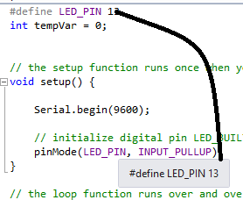
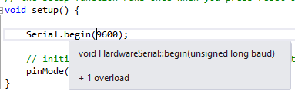
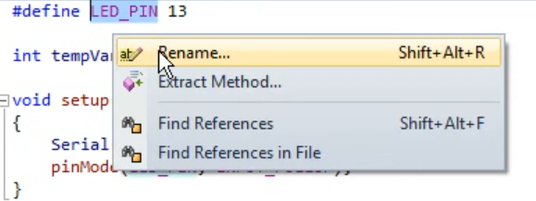
VS Micro Vs Arduino
"Provides an advanced and professional development environment, and allows for more advanced development than the existing Arduino IDE"
VS Micro
intellisense
Can be used in VS and Atmel
The breakpoint location might be invalid?
Error handling: expected ';' before '}‘
Formated code
File as Libary in solution
Global rename
Auto reconnect, logging...
Arduino
+LightWeight (fast)
+Simple

Slide 13
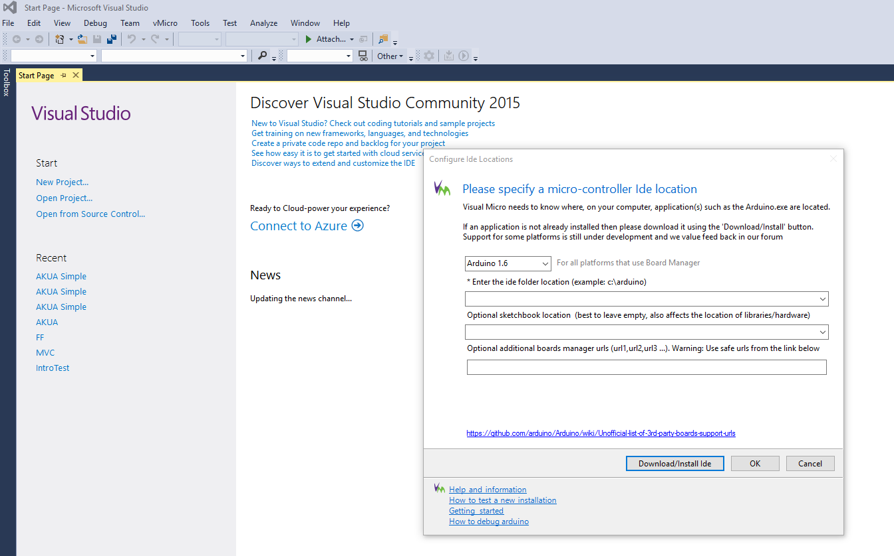
VS Micro – Installation / Configuration
Get Arduino and cabel
Install arduino IDE
VS Community (08-15) -> NOT Express

Slide 14
Example projekta Samohodni Autic
Demo
https://youtu.be/Q1L_YQG4v_o
C:\Users\kdeka\OneDrive\Documents\1. Development\_Arduino prezentation\vids

Slide 15
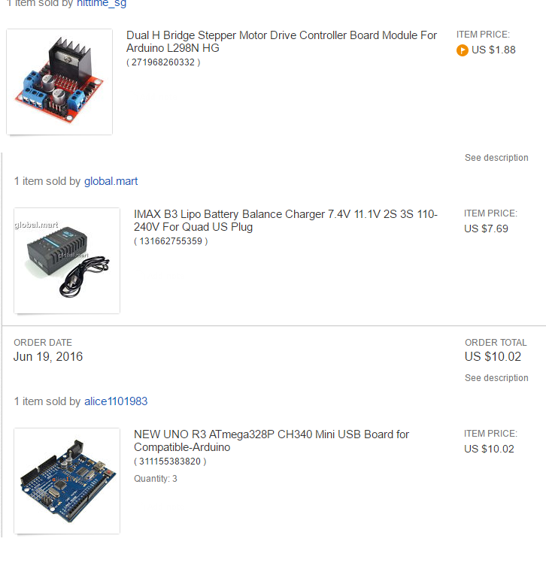
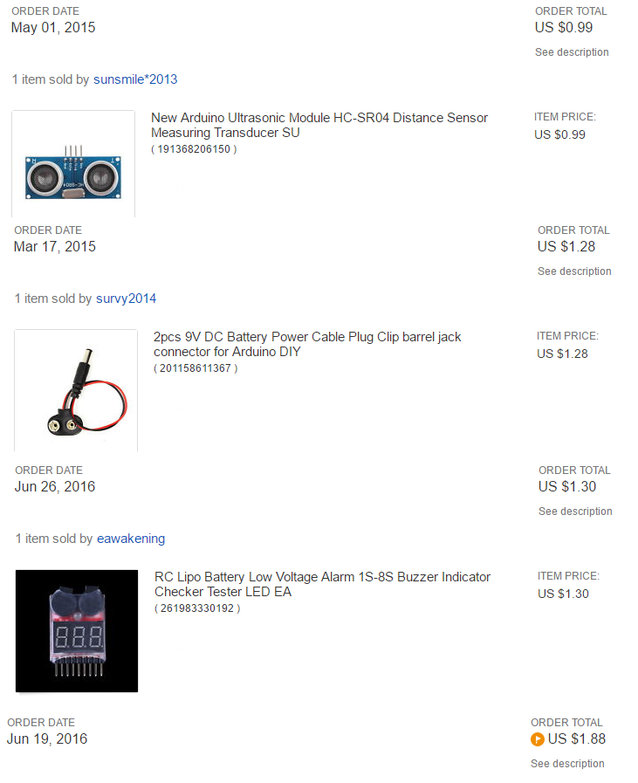

Slide 16
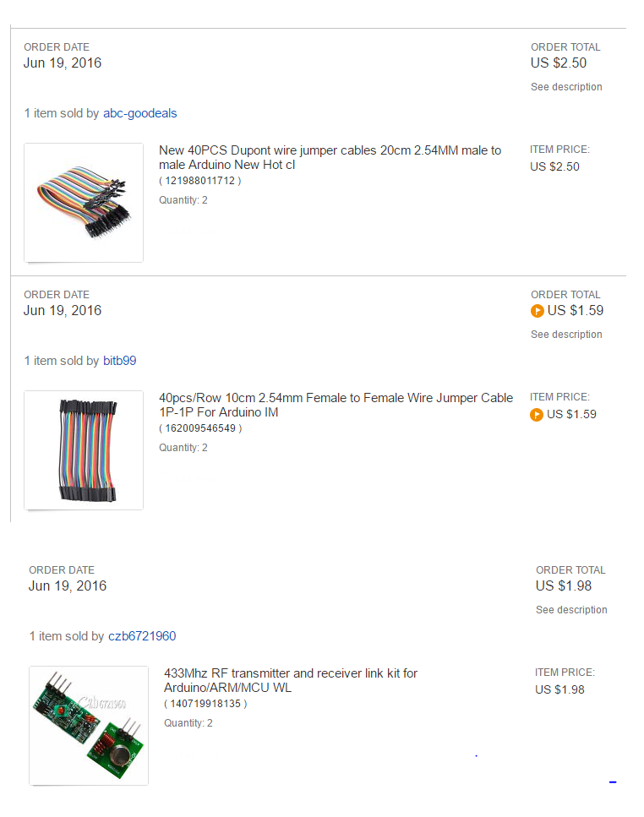
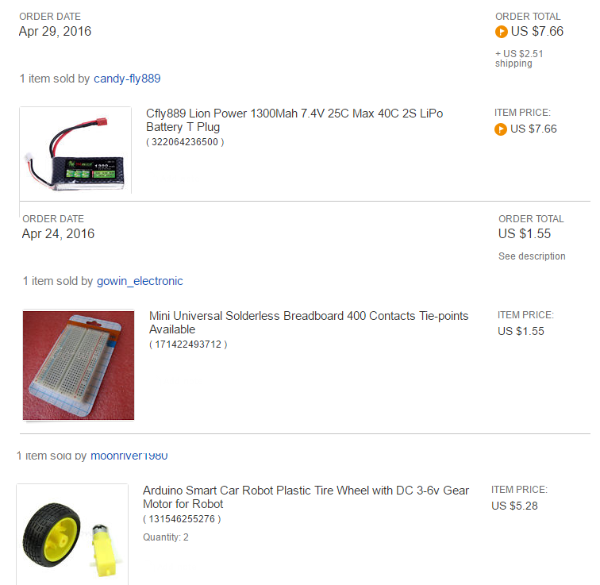

Slide 17
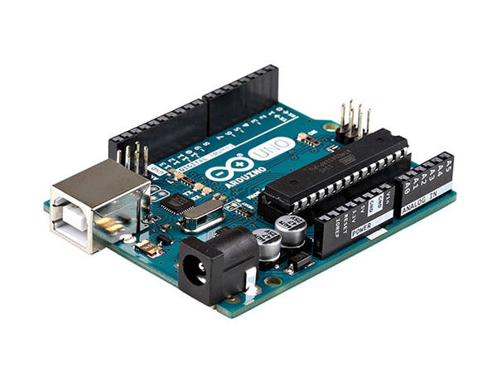

Kako sam naučio Arduino?
aa

Slide 18
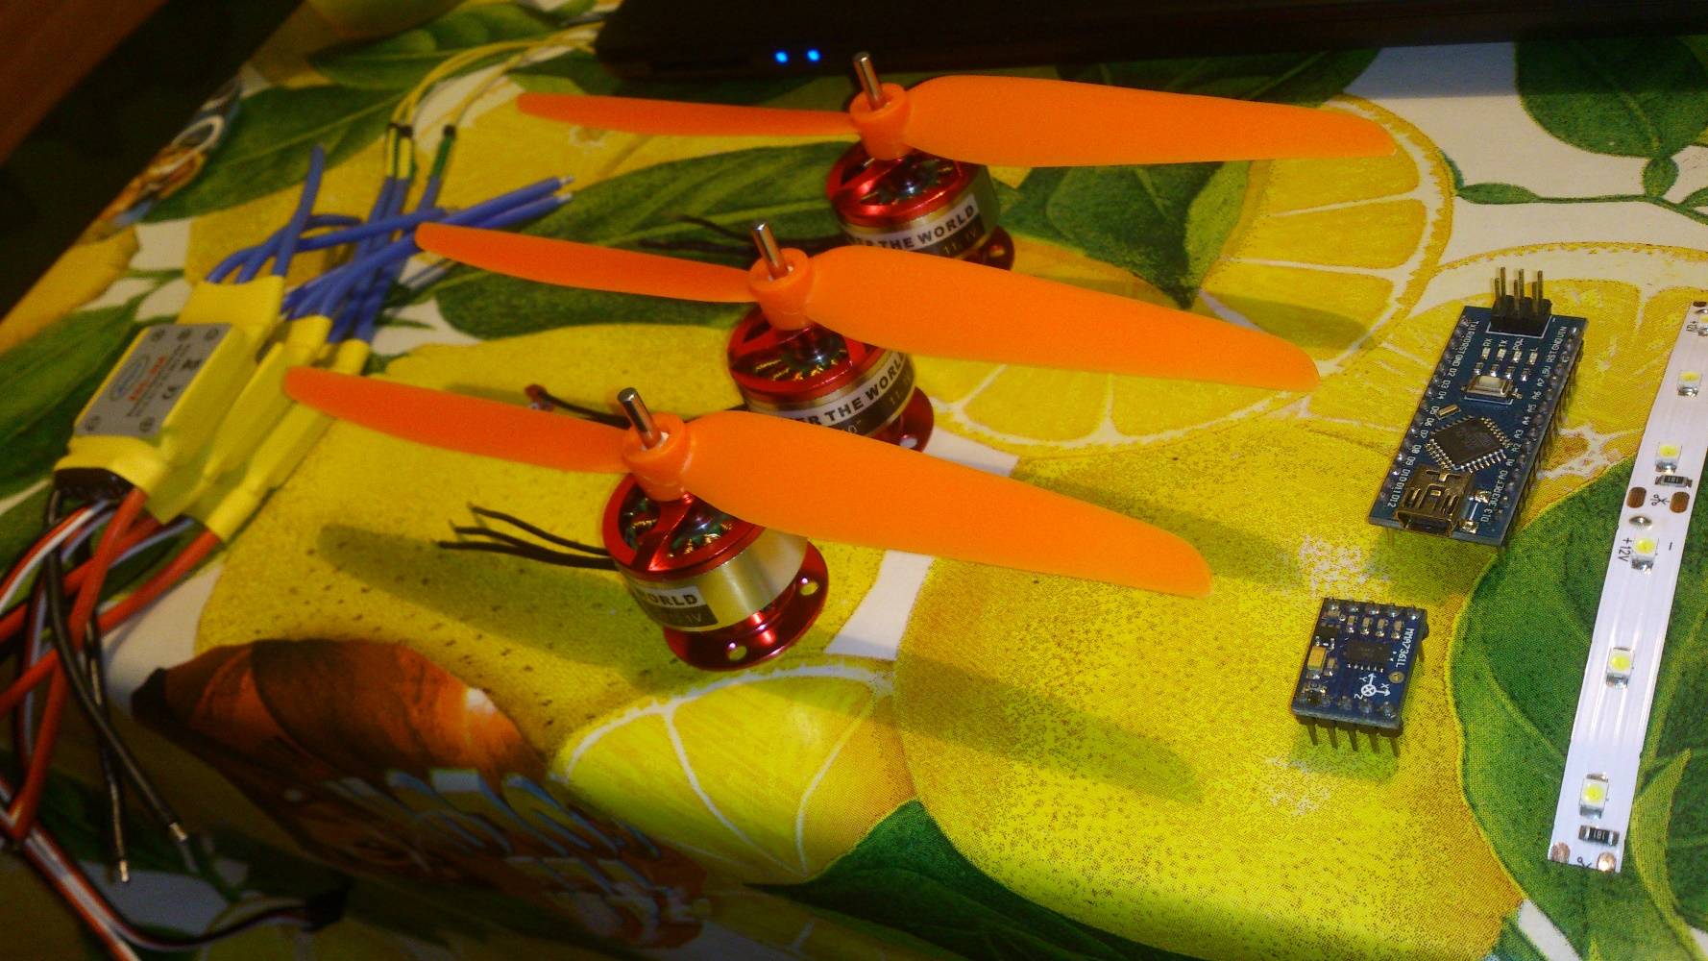
Istraživanje komponenata

Slide 19
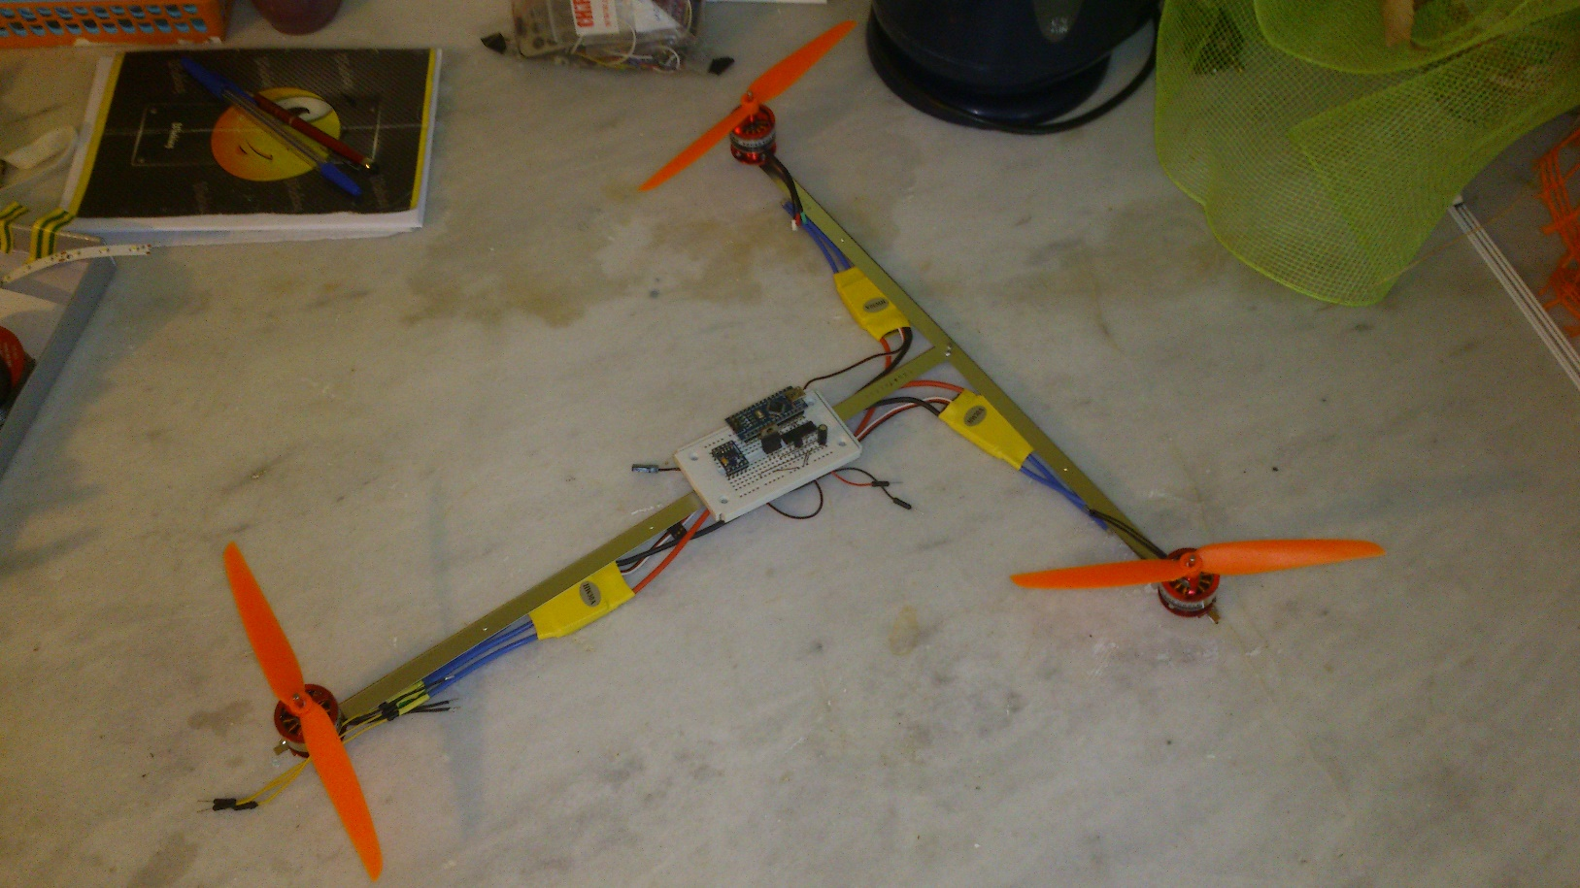
Dizajn #1

Slide 20
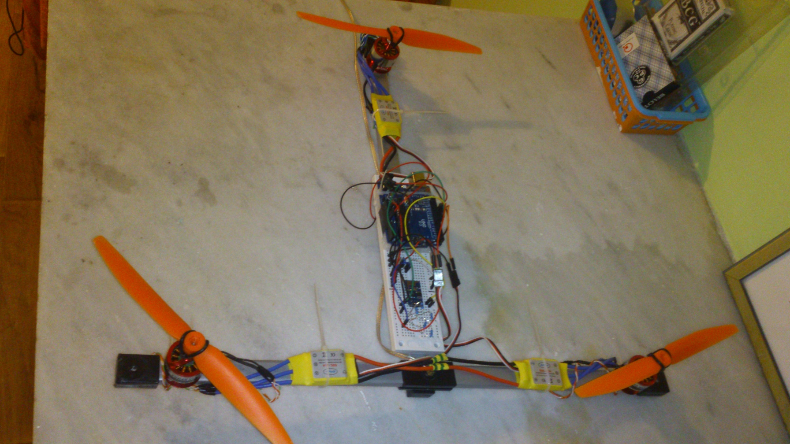
Dizajn #2

Slide 21
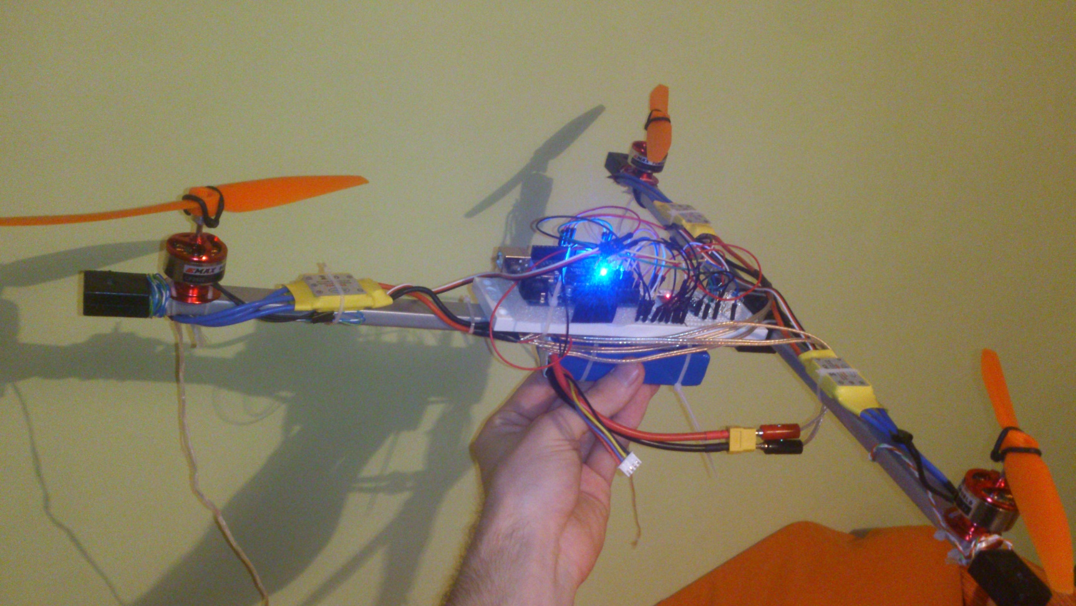
Dizajn #3

Slide 22
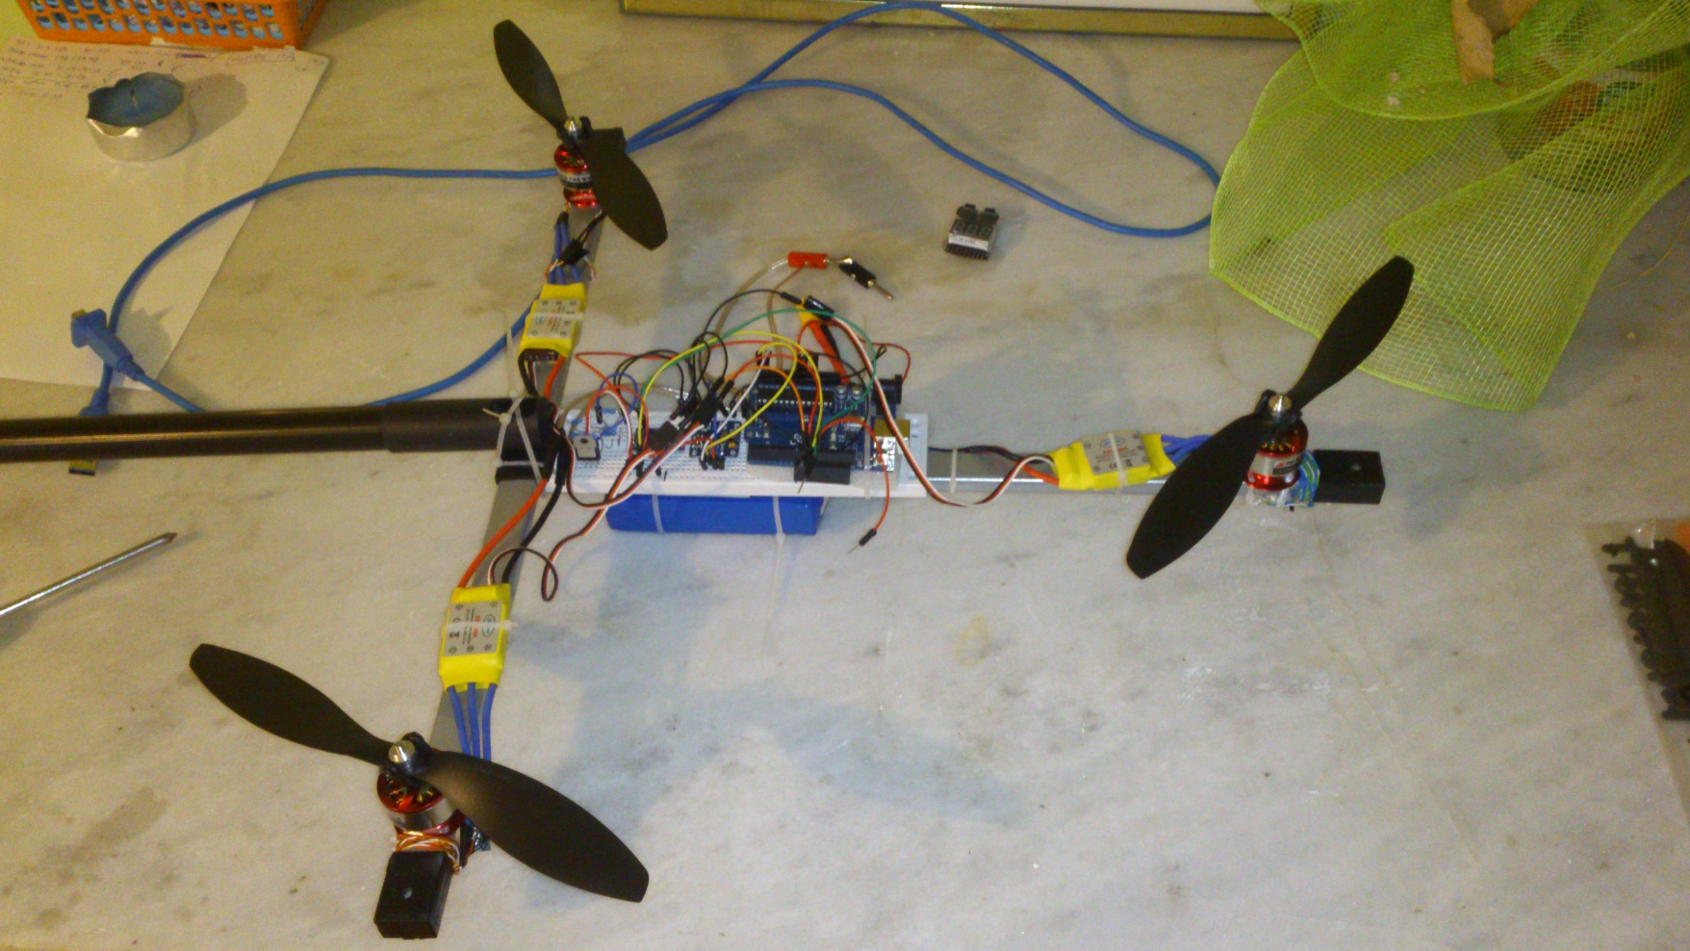
Dizajn #4

Slide 23
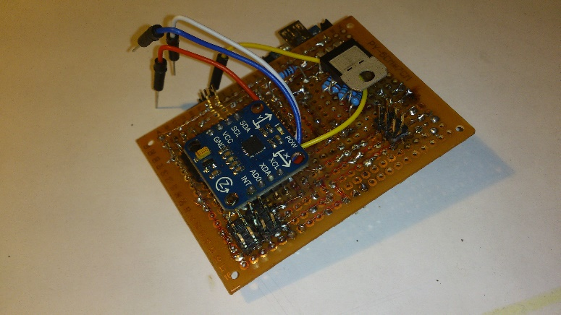
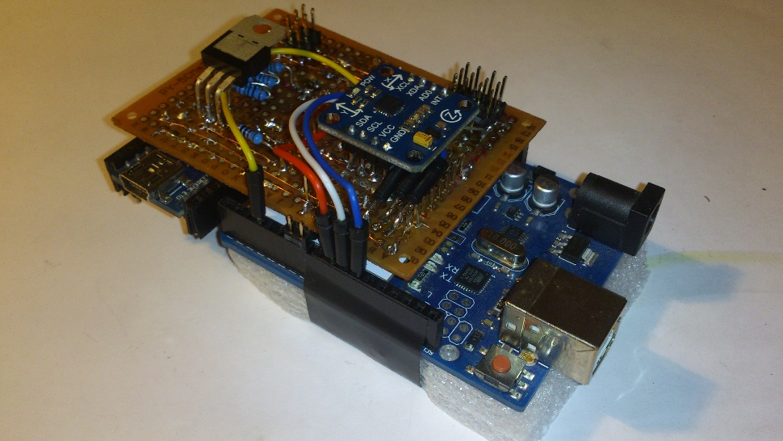
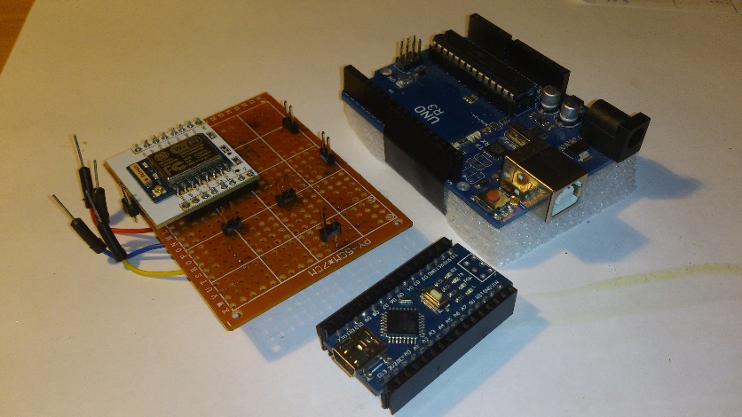
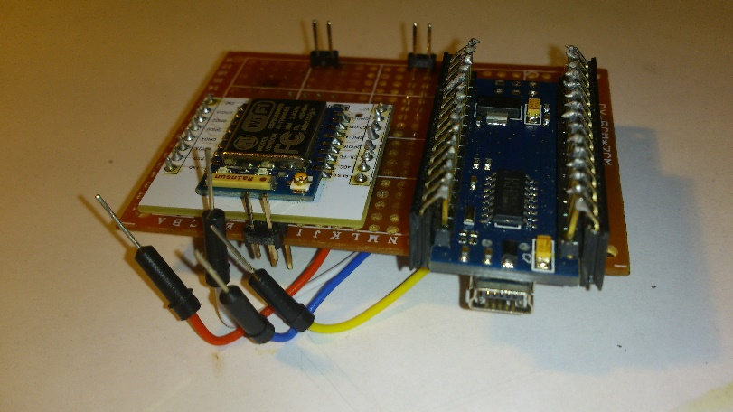

Slide 24
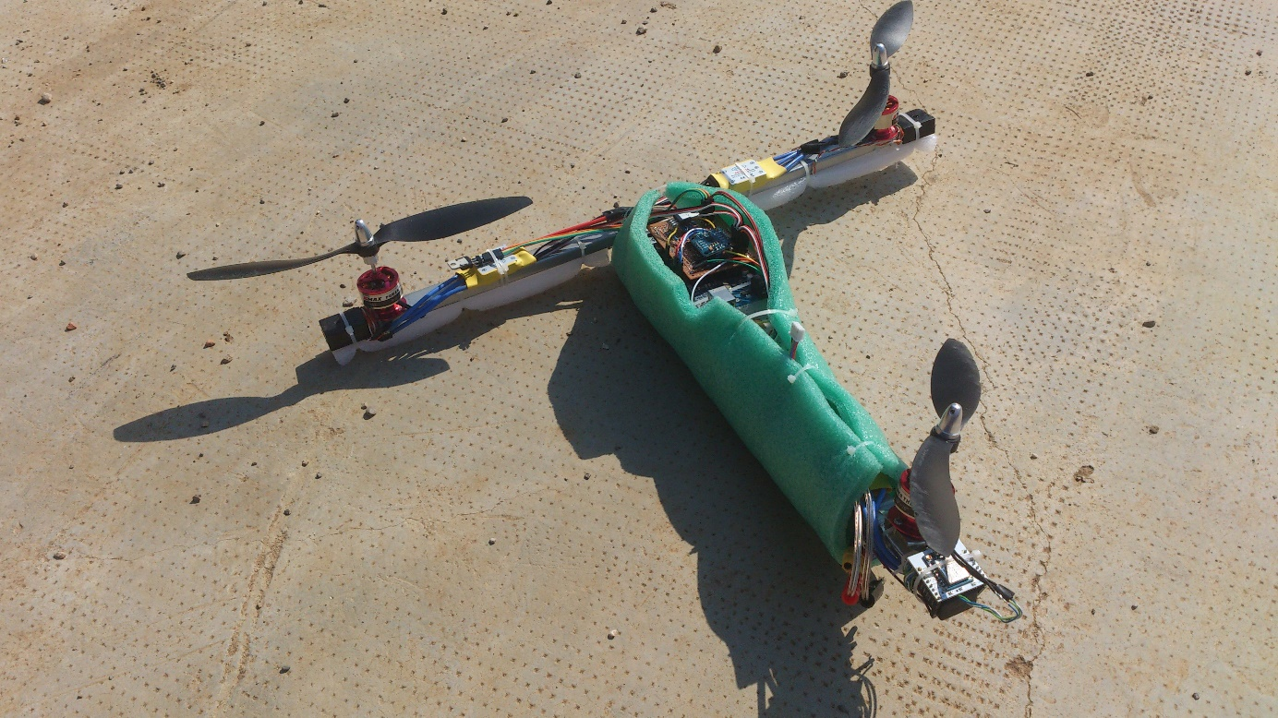
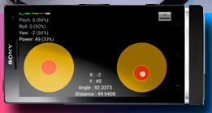
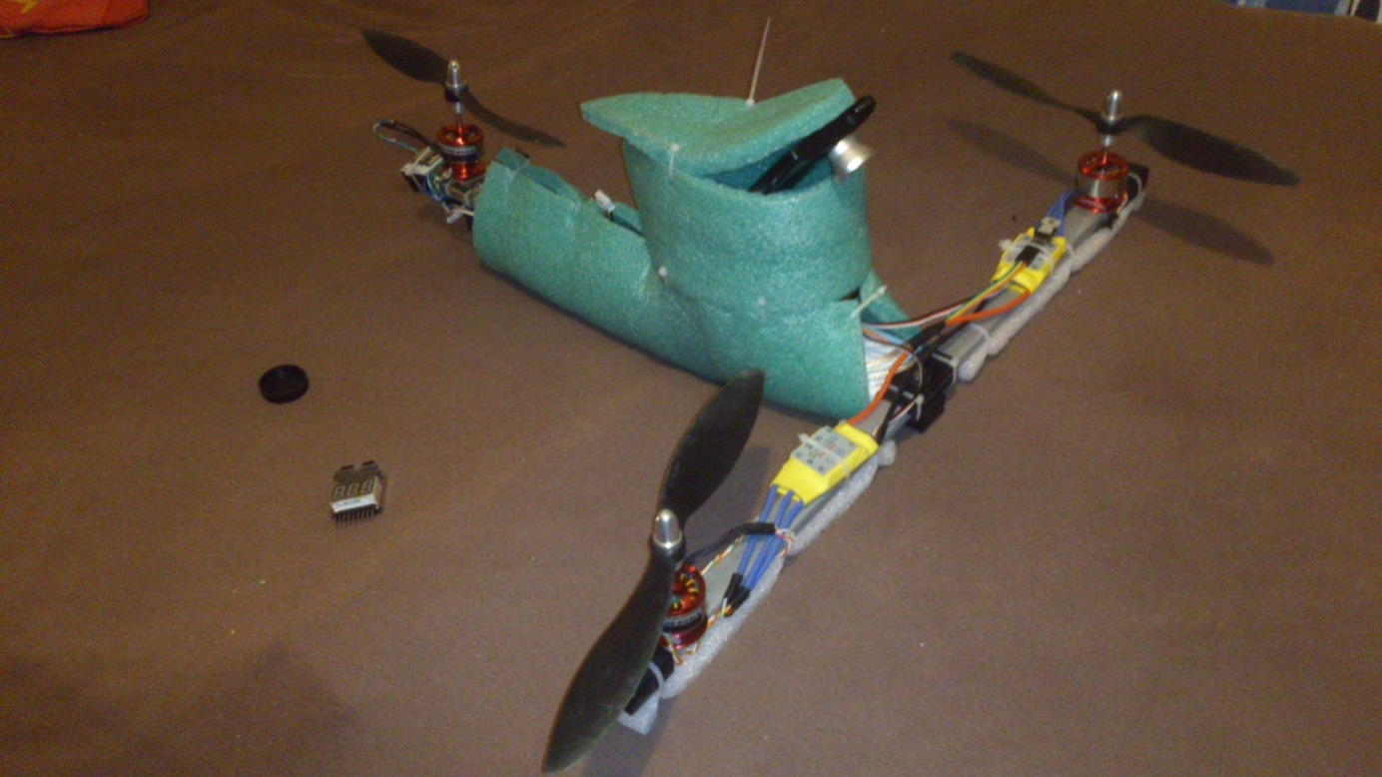
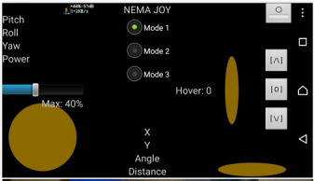
Demo
Video #1
Video #2
Video #3
Uživo ☺

Slide 25
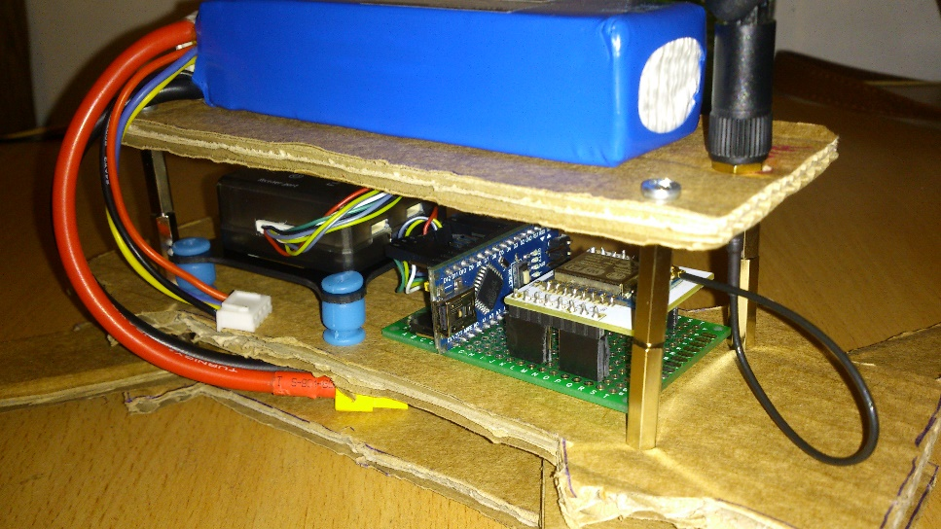
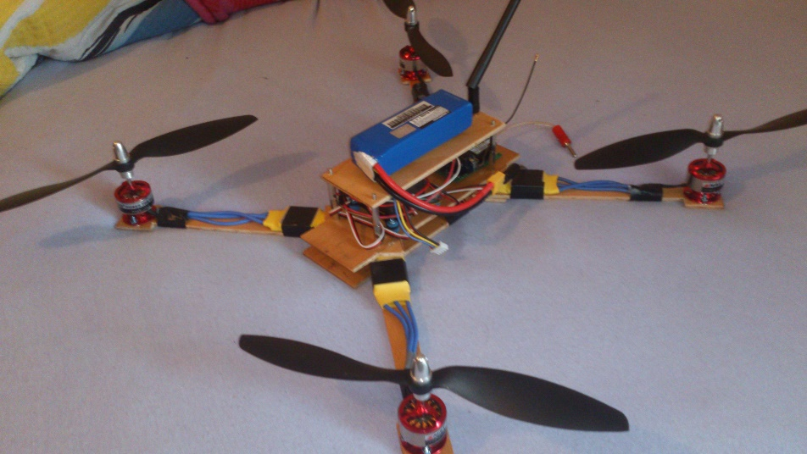
Demo
Video #1
Video #2
Video #3
Uživo ☺

Slide 26
Problemi
Problem #1 – „Vaga”- PID Controller
Problem #2 – Komunikacija s Arduinom
Problem #3 – PWM/PPM signal
Problem #4 – Koliko ima digitalnih izlaza?
Problem #5 - Pull-Up/Pull-Down Resistors

Slide 27
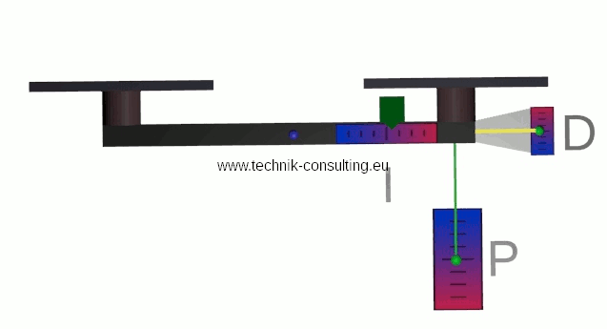
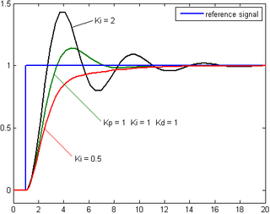
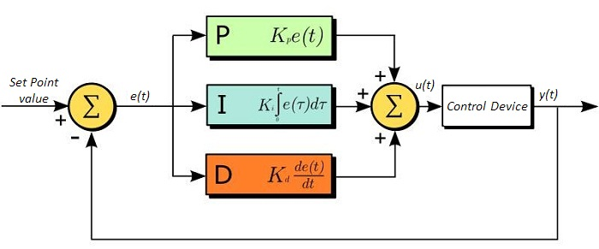
Problem #1 – „Vaga”- PID Controller

Slide 28
Problem #2 – Komunikacija s Arduinom
- Istovremeno čitanje dolaznih podataka s WiFi-a i stabilizacija
- Delay nakon čitanja serial.Read() ili serial.Available()
- Multithreading?
- Čitaj samo jedan character po ciklusu „loop()” funkcije
:50 50 50 0;
:50 50 50 1;
:50 50 50 2;
...
:50 50 50 30;
:51 50 50 30;
:52 50 50 30;
...
:60 50 50 30;
:60 51 50 30;
:60 52 50 30;
...
:50 60 50 30;
…

Slide 29
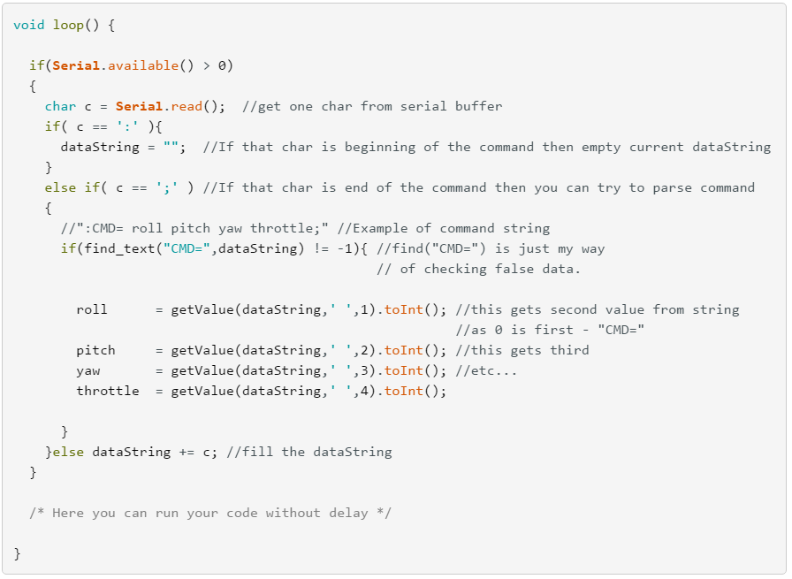

Slide 30
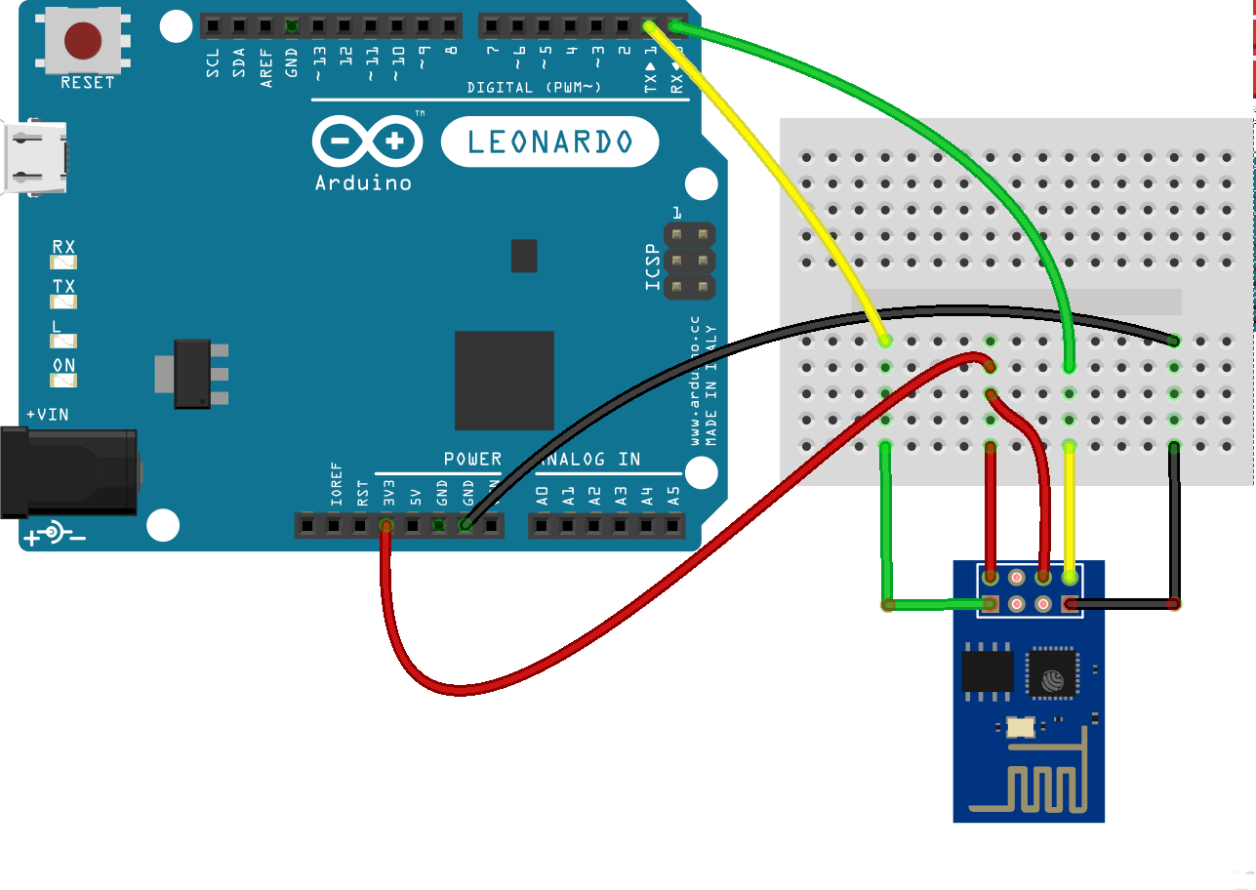
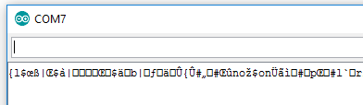
Problem #2 – Komunikacija s Arduinom
- 3.3v regulator
- ESP8266 current: 250mA
- Arduino 3.3v = max 150mA

Slide 31



Problem #3 – PWM/PPM signal
- PWM je analogni digitalni signal
- Pulse Width Modulation vs Pulse Position Modulation
- 6 PWM izlaza na 3 interna timera PPM
Pin 5 i 6: timer0
Pin 9 i 10: timer1
Pin 3 i 11: timer2

Slide 32

Problem #4 – Koliko ima digitalnih izlaza?
- Kako upravljati s mnogo više digitalnih izlaza nego što ih ima Arduino?
- Demultipleksor
- Shift registri

Slide 33


Prob. #4 – Shift Register

Slide 34



Trik #1 – Koliko ima digitalnih izlaza?

Slide 35


Problem #5 - PullUp/PullDown otpornici
a

Slide 36


Ideje za projekte
- Autonomni autić
- Dronovi
- Display pomoću shift registara
- LED traka aktivirana po zvuku
- HDD laser projektor
- PIR WiFi alarm

Slide 37
Što od el. komponenata je dobro imati?
- Arduino ☺
- Step-Up converter
- Step-Down converter
- 5v regulatori
- 3.3v regulatori
- TIP122 tranzistori
- ESP8266 (koji i koje su prednosti u odnosu na druge modele)
- Senzori

Slide 38
Oprez!
- Ako kontrolirate nešto „opasno” pomoću mobitela stavite ga u airplane mod! Zašto? Da vas netko ne nazove u kritičnoj situaciji ☺

Slide 39
Ako bude vremena ☺
- Načini komunikacije među više arduina.
Wifi, bluetooth,
serial, software serial
I2C, PPM
- LiPo baterije - koliko su jake i opasne, koliku struju mogu davati
1300mAh * 40C = 52000mAh = 52A
- Razlika: stepper vs servo motor
Servo zna gdje se nalazi i koliko je okrenut a stepper je „glup”
- Upravljanje motorom u 2 smjera
H bridge

Slide 40
return 0; //Success

